Slide 1
Mail Box Notification Using Light Sensor and IFTTT
.

Slide 2
.
Problem to be solved:
Get Real time notification in cell phone when mail box is open
Can eliminate the wasted trip to check the mail delivery, especially for people with health problems or disabilities.
Component Used:
Particle Photon: 2.4 GHz frequencies, Broadcom BCM43362 Wi-Fi chip, Real-time operating system (FreeRTOS), Easy integration with cloud, Low Power Consuming device with Vin= 3.6 to 5.5VDC
Photo Resistor: Light dependent resistor
IFTTT Platform: Web-based service to create chains of conditional statements.

Slide 3
Proposed Solution:
Photon is integrated with the light sensor and 220 ohm resistor.
A photo resistor will decrease resistance as it is exposed to higher intensity of light, allowing for a higher voltage reading on the particle, and vice-versa
The code is set up to take reading and publish the events to the cloud using Particle.publish API.
IFTTT applet is setup to look for events in cloud published from the photon, this is the Particle.publish line in the code.
Once the event is found, IFTTT sends message to Cellphone.

Slide 4
Block Diagram
IFTTT
Cellphone
Photon and Sensor
Cloud

Slide 5
Features:
Scalability: - Like Amazon Key or service which deliver package inside the home, what if we have the real time alert for mail and we can open the door over the internet for USPS.
- We no longer have to depend upon only Amazon for package delivery.
- Can be used for security purpose against tampering
Low Power Consumption: Photon operates on Vin= 3.6 to 5.5 volt
Low cost: The photon and light sensor really cost less.
Future Enhancement:
Solar Power can be used to supply power to photon.

Slide 6
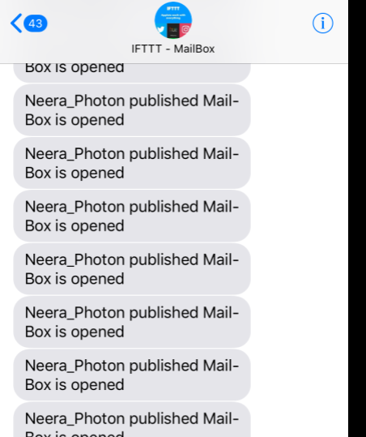
Demonstration

Slide 7
.
Thanks

